Slide 1
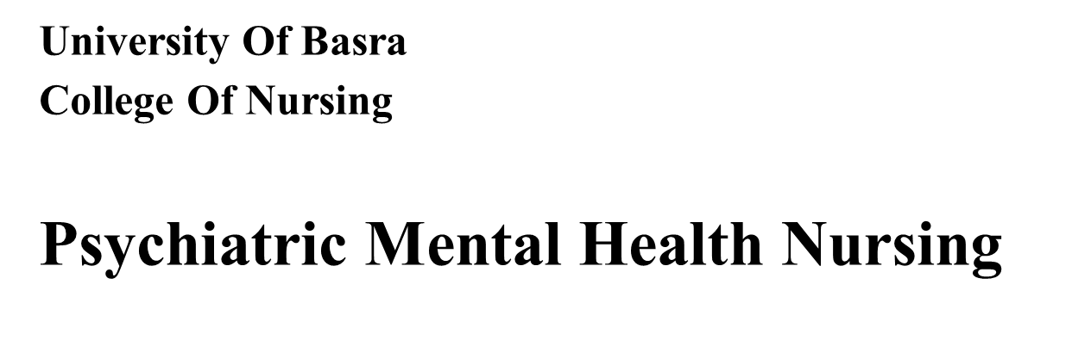
Foundations of Psychiatric–Mental Health Nursing

Slide 2
History concepts
Ancient Times
People of ancient times believed that any sickness indicated displeasure of the gods and, in fact, was a punishment for sins and wrongdoing. Those with mental disorders were viewed as either divine or demonic, depending on their behavior. Individuals seen as divine were worshipped and adored; those seen as demonic were ostracized, punished, and sometimes burned at the stake.

Slide 3
Later, Aristotle (382–322 BC) attempted to relate mental disorders to physical disorders and developed his theory that the amounts of blood, water, and yellow and black bile in the body controlled the emotions. These four substances, or humors, corresponded with happiness, calmness, anger, and sadness. Imbalances of the four humors were believed to cause mental disorders; therefore, treatment was aimed at restoring balance through bloodletting, starving, and purging. Such “treatments” persisted well into the 19th century.

Slide 4
In early Christian times (1–1000 AD), primitive beliefs and superstitions were strong. All diseases were again blamed on demons, and the mentally ill were viewed as possessed. Priests performed exorcisms to rid sufferers of evil spirits. When that failed, they used more severe and brutal measures, such as incarceration in dungeons, flogging, and starving.
In England during the Renaissance (1300–1600), people with mental illness were distinguished from criminals. Those considered harmless were allowed to wander the countryside or live in rural communities, but the more “dangerous lunatics” were thrown in prison, chained, and starved.

Slide 5
In 1547, the Hospital of St. Mary of Bethlehem was officially declared a hospital for the insane, the first of its kind. By 1775, visitors at the institution were charged a fee for the privilege of viewing and ridiculing the inmates, who were seen as less than human animals. During this same period in the colonies (later the United States), the mentally ill were considered evil or possessed and were punished.

Slide 6
Period of Enlightenment and Creation of Mental Institutions
In the 1790s, a period of enlightenment concerning persons with mental illness began. Philippe Pinel in France and William Tuke in England formulated the concept of asylum as a safe refuge or haven offering protection at institutions where people had been whipped, beaten, and starved because they were mentally ill.

Slide 7
Sigmund Freud and Treatment of Mental Disorders
The period of scientific study and treatment of mental disorders began with Sigmund Freud (1856–1939) and others, such as Emil Kraepelin (1856–1926) and Eugen Bleuler (1857–1939). With these men, the study of psychiatry and the diagnosis and treatment of mental illness started in earnest. Freud challenged society to view human beings objectively. He studied the mind, its disorders, and their treatment as no one had done before.. Kraepelin began classifying mental disorders according to their symptoms, and Bleuler coined the term schizophrenia.

Slide 8
Development of Psychopharmacology
A great leap in the treatment of mental illness began in about 1950 with the development of psychotropic drugs, or drugs used to treat mental illness.

Slide 9
Move toward Community Mental Health
The movement toward treating those with mental illness in less restrictive environments gained momentum in 1963 with the enactment of the Community Mental Health Centers Construction Act. Deinstitutionalization, a deliberate shift from institutional care in state hospitals to community facilities, began. Community mental health centers served smaller geographic catchment, or service, areas that provided less restrictive treatment located closer to individuals’ homes, families, and friends. These centers provided emergency care, inpatient care, outpatient services, partial hospitalization, screening services, and education.

Slide 10
MENTAL ILLNESS IN THE 21ST CENTURY
Some believe that deinstitutionalization has had negative as well as positive effects. Although deinstitutionalization reduced the number of public hospital beds by 80%, the number of admissions to those beds correspondingly increased by 90%. Such findings have led to the term revolving door effect. Although people with severe and persistent mental illness have shorter hospital stays, they are admitted to hospitals more frequently. The continuous flow of clients being admitted and discharged quickly overwhelms general hospital psychiatric units.
The practice of boarding leads to frustration of health care personnel, dissatisfaction with care for clients and their families, and some believe an increase in suicide.

Slide 12
Concept of Mental Health and Mental Illness
Psychiatry: is the branch of medicine which deals with the diagnosis, treatment and prevention of mental illness.
Psychiatric nursing: is a branch of nursing concerned with the promotion of mental health, prevention of mental disorder and provide nursing care for patient who is suffer from mental disorder.
Mental health and mental illness are difficult to define and are influenced by one’s culture and society.
The World Health Organization defines health as a state of complete physical, mental, and social wellness, not merely the absence of disease or infirmity.

Slide 13
Mental health
Mental Health a state of emotional, psychological, and social wellness evidenced by satisfying interpersonal relationships, effective behavior and coping, positive self-concept, and emotional stability.
Characteristics of Mental Health
A positive attitude toward self
Growth, development, and the ability to achieve self-actualization
Integration
Autonomy and independence.
Perception of reality
Environmental mastery.

Slide 14
Factors that Influencing Mental Health
Individual Factors (biologic makeup, autonomy and independence, self-esteem, capacity for growth, vitality, ability to find meaning in life, resilience or hardiness, sense of belonging, reality orientation, and coping or stress management abilities).

Slide 15
Interpersonal Factors, including (effective communication, helping others, intimacy, and maintaining a balance of separateness and connectedness).
Social/Cultural Factors, including (sense of community, access to resources, intolerance of violence, support of diversity among people, mastery of the environment, and a positive yet realistic view of the world).

Slide 16
Mental illness
is an illness or syndrome that affect mood, behavior, and thinking, such as depression, schizophrenia, anxiety disorders, and addictive disorders. Mental disorders often cause significant distress or impaired functioning or both. Individuals experience dissatisfaction with self, relationships, and ineffective coping

Slide 17
Characteristics of Mental illness
Inability to cope
Inability to establish a meaningful relationship.
Displays poor judgment.
Exhibits dependency needs.
Inability to perceive reality.
Avoid problems.

Slide 18
Factors Contributing to Mental Illness
Individual Factors include (biologic makeup, intolerable or unrealistic worries or fears, inability to distinguish reality from fantasy, intolerance of life’s uncertainties, a sense of disharmony in life, and a loss of meaning in one’s life).
Interpersonal Factors include (ineffective communication, excessive dependency on or withdrawal from relationships, no sense of belonging, inadequate social support, and loss of emotional control).

Slide 19
Social/Cultural Factors include (lack of resources, violence, homelessness, poverty, an unwarranted negative view of the world, and discrimination such as stigma, racism, classism, ageism, and sexism. It is important to note that some of these social/cultural factors can result in isolation, feelings of alienation, and maladaptive, violent, or criminal behavior).

Slide 20
Diagnostic And Statistical Manual Of Mental Disorders
The Diagnostic and Statistical Manual of Mental Disorders, fifth edition (DSM-5), is a taxonomy published by the American Psychiatric Association and revised as needed. The current edition made some major revisions and was released in 2013.
The DSM-5 has three purposes:
To provide a standardized nomenclature and language for all mental health professionals
• To present defining characteristics or symptoms that differentiate specific diagnoses
• To assist in identifying the underlying causes of disorders

Slide 21
The classification system allows the practitioner to identify all the factors hat relate to a person’s condition:
All major psychiatric disorders such as depression, schizophrenia, anxiety, and substance-related disorders
• Medical conditions that are potentially relevant to understanding or managing the person’s mental disorder as well as medical conditions that might contribute to understanding the person
• Psychosocial and environmental problems that may affect the diagnosis, treatment, and prognosis of mental disorders. Included are problems with the primary support group, the social environment, education, occupation, housing, economics, access to health care, and the legal system.

Slide 22
Thank you

